Slide 1
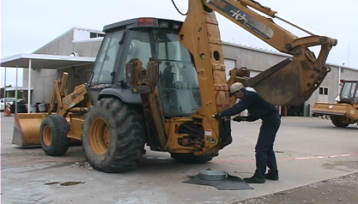
6. MCM-6 Waste Handling at Municipal Facilities: Other MS4 Operations
Green Country Stormwater Alliance (GCSA)
Employee Training Series
Prepared by INCOG
March 2021
Notes:
The first 5 Modules of this MCM-6 GCSA Employee Training series covered the municipal operation topics mentioned in the OKR04 permit.
However, many cities and some counties also have other types of operations or provide certain community services that can also create pollution and impact water quality.
This final MCM-5 training module covers pollution from these “extra” municipal activities.

Slide 2
This GCSA MCM-6 Training Series Has Covered:
Introduction to MCM-6 training requirements.
Municipal park and open space maintenance.
Municipal fleet and building maintenance.
MS4 new construction and land disturbance.
MS4 stormwater system maintenance.
This final presentation covers several additional types of municipal activities that can affect water quality.
Notes:
Over the many years of managing GCSA, the goal of INCOG has been to offer presentations in GCSA Employee Training Workshops on the MCM-6 training required in OKR04.
The COVID-19 pandemic prevented all workshop meetings in 2020 and the first half of 2021.
As a substitute, INCOG has prepared these 6 modules to cover the same training material that would have been offered in workshops.
Each GCSA Member can use each of these modules for local training, either as a simple PowerPoint, or viewing each slide with its notes.
INCOG plans to return to workshops in the second half of 2021, but MCM-6 topics will not be re-presented until sometime in 2022.

Slide 3
Municipal pools and splash pads.
Municipal lakes and ponds.
Wastewater treatment plants (WWTPs).
Water treatment plants and other utilities.
Municipal landfills.
Municipal stormwater flood control structures.
Municipal LID structures.
Additional Municipal Activities & Operations
Notes:
Over the years, INCOG has received questions about these various “other” types of municipal operations and what requirements are in OKR04 for each of these.
This final module collects all into a single presentation.
These activities can generate pollution problems that can be addressed effectively with standard BMPs designed to control pollution in stormwater.

Slide 4
Municipal Pools:
Possible causes of pollution
Piping pool water into stormdrains, streets or creeks.
Backwash water piped to storm drains, streets or creeks.
Plumbing leaks.
Chemical spills.
Vandalism.
Notes:
Many cities own and operate community pools.
There is a surprising amount of maintenance required, much of which that can generate toxic pollutants which require BMPs to control.
The same types of pollution are associated with private backyard pools, but municipal pools are of course much larger in scale.
The slide lists potential sources of pollution from operation and maintenance that require BMPs and diligence to control pollution.
The goal of these BMPs is to prevent chemicals and even the pool water itself from entering streets, culverts, ditches and creeks.
All spills and chemical releases, solids and liquids, should be cleaned up immediately and the material disposed of properly.
Your supervisor should have formal procedures for all spill cleanup procedures and disposal methods.
Remember, some pool chemicals can evaporate quickly creating toxic fumes, so personal safety must be assured by adequate training in safe chemical handling.

Slide 5
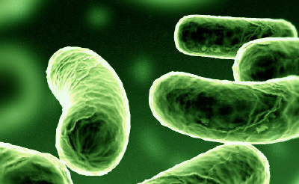
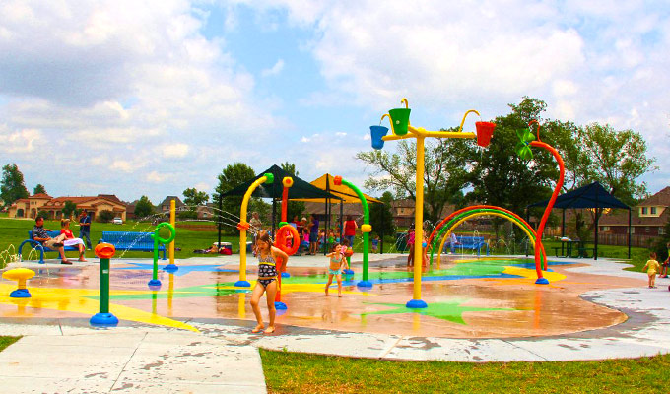
Municipal Splash Pads
Three types:
Flow-Through (tap water to sanitary sewer).
Recirculate (capture, treat, Reuse).
Irrigation (capture, pipe to irrigation fields or gardens).
Pathogens associated with splash pad runoff:
Naegleria fowleri (amoeba)
Cryptosporidium (protozoan parasite)
Other pathogens (bacteria, viruses, etc.)
Notes:
Many GCSA members now own and operate recreational splash pads at city parks. These are very popular and well attended each year, but they can pose environmental problems.
There are 3 operational types: flow through, recirculate and irrigation, and each has its own operational practices and requirements.
The most important operational public health consideration is maintaining disinfection of the water to kill potential pathogenic organisms that grow in warm water.
There are 3 pathogen types that have been associated with community splash pads: N. fowleri (a very infectious amoeba), Cryptosporidium, and a variety of bacteria and viruses.
While splash pad infections around the country are rare, it is important that cities maintain disinfection of splash pad water, and this involves use of chemicals.
The same plumbing, runoff and spill release concerns of pools applies to splash pads.
Operators should be trained to deal with daily operations as well as how to handle spill releases from accidents, equipment failures and vandalism.

Slide 6
2010 Oklahoma Legislature exempted splash pads from safety and testing regulations.
No state testing program now.
Standing water on the pad can be contaminated.
Runoff into shallow pools of water and mud by pads can be contaminated.
2005 Mohawk Park shallow pools by splash pad Naegleria incident.
Over-chlorination can also cause polluted runoff.
Municipal Splash Pads
Notes:
In 2010, the Oklahoma State Legislature exempted splash pads from many safety and testing regulations.
However, this should not be considered a reason to ignore public safety or pollution potential of splash pad operations.
Any shallow body of warm water in hot summer can dissipate chlorine quickly reducing disinfection potential of the system.
In addition, some splash pads have water runoff into adjacent shallow dirt ponds, even just a few inches deep, that attract playful kids.
These muddy areas can easily lose all disinfection from chlorine quickly, and the added organic materials and native bacteria from the soil can enhance the growth of pathogens.
Proper operation also means not adding too much chlorine as well. Chloring overloads can cause skin and eye irritations as well as increased pollutant levels into nearby creeks.

Slide 7
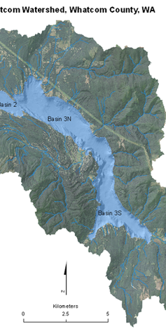
Municipal Lakes
Resources to be protected.
Pollution enters mainly from shoreline and tributaries.
Most city limits cover only the lake and a narrow buffer around the lake.
Most common lake impairments:
Dissolved oxygen
pH
Nutrients
Turbidity
Notes:
Many GCSA members own and maintain municipal lakes. These may be used for emergency water supplies as well as for recreation.
Even though the city may not own much of the watershed itself, they typically do own the shoreline and roads and park areas around the lake.
Most municipal lake watersheds are mostly native vegetation with abundant forest. These areas are usually not major contributors of water pollution in lakes.
However, shoreline and recreational park areas near shorelines are considered pollution sources that should have BMP controls of pollution in runoff.
Many municipal lakes are presently on the 303(d) List of impaired waters, mostly for dissolved oxygen, pH, nutrients and/or turbidity.
There are BMPs that a city can implement to help control sources of pollution that contribute to impairment.

Slide 8
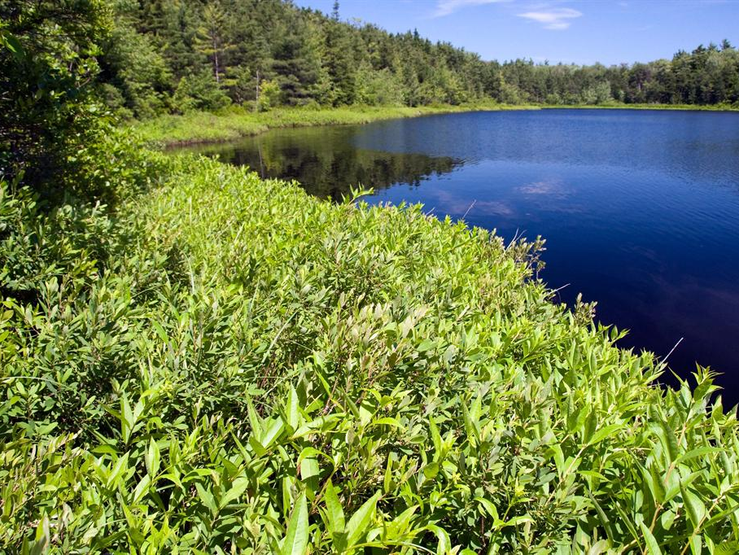
Typical BMPs for Municipal Lakes
Bank and shoreline stabilization and erosion control.
Vegetative cover; forest management.
Pervious surfaces for parking lots, paths.
Near shore emergent aquatic plants as buffers.
Public education about trash, fish offal, food waste.
Control of fertilizers, pesticides and other chemicals.
Mechanical aeration of water column.
Organized lake cleanups and environmental events.
Notes:
Typical lake BMPs that an MS4 city can implement include those listed in Slide 8.
Most involve controlling pollution along the shoreline and in public recreational areas.
The MS4 should apply a variety of education outreach to lake visitors to reduce indiscriminate discarding of trash, food and fish offal.
The city can also limit or find alternatives to use of pesticides and fertilizers for shoreline and lake park control of insects and vegetation.
Lake cleanup events can be organized for trash removal.
Lakes are also a scenic venue to host environmental awareness events for the local community.
For certain impairments, mechanical aeration devices can be deployed strategically in the lake to increase oxygen and reduce nutrient problems.
The Oklahoma Department of Wildlife Conservation (ODWC) and US Fish and Wildlife Service (FWS) are agencies that can assist cities with lake management options.

Slide 9
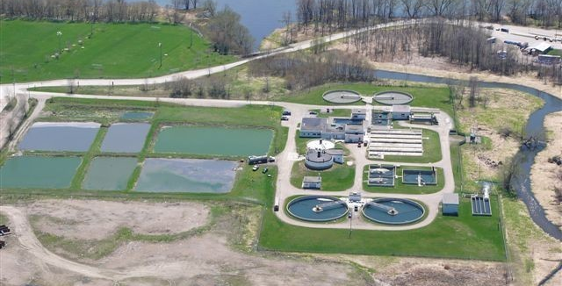
OKR05 covers WWTPs >1 MGD; OKR04 covers <1 MGD.
OKR04 covers water plants, not OKR05.
Use standard facility BMPs for WWTPs and water plants.
OKR04 MCM-6 covers other MS4 utilities (e.g., electric, gas, transfer stations, etc.).
Wastewater Treatment and Water Plants
Notes:
Cities with Wastewater Treatment Plants (WWTPS) 1 MGD or greater design flow have stormwater permit coverage under OKR05; all other WWTPs are covered by OKR04’s MCM-6 requirements.
City Water Treatment Plants (WTPs) are not covered by OKR05, they are covered by OKR04’s MCM-6 requirements.
WWTP and WTP operations covered by OKR04 are subject to OKR04’s requirements for inspections, chemical storage, spill cleanup and all other pollution controls used for other MCM-6 facilities.
The city’s Stormwater Manager should coordinate with the superintendents of the WWTP and WTP so that the proper stormwater BMPs are used.
OKR04’s MCM-6 requirements also cover all other Public Works utility operations as well, such as any municipally owned and operated gas and electric systems.

Slide 10
Municipal Landfills
OKR05 covers “Stormwater discharges from facilities associated with waste disposal at landfills, and land application sites that receive or have received industrial waste, including sites subject to regulation under Subtitle D of RCRA, are covered under Sector L.”
OKR04 MCM-6 covers all other municipal landfills not covered by OKR05.
Use standard facility BMPs.
Notes:
One of the 29 “Sectors” of industrial activities in the OKR05 permit is for certain municipally owned and operated landfills.
The specific qualifying provision from OKR05 is listed in the slide above.
If a municipal landfill does not meet this OKR05 coverage qualification, then OKR04’s MCM-6 requirements apply to the landfill.
The landfill operator or manager should be cooperating with the city’s Stormwater Manager to implement all MCM-6 requirements.
MCM-6 has general requirements for all city operations; they are not broken down by specific facility type.
Therefore, general BMP deployment requirements to prevent pollution in runoff apply, including inspections.
Each MCM-6 operation has the flexibility to deploy those BMPs most suited to local conditions; they are not specifically prescripted in OKR04.

Slide 11
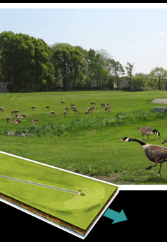
Stormwater Flood Control Structures
Most basins are dry, some have permanent water.
Controlling pollution discharges from basin outlets:
Pollutants flowing into basins: (e.g., nutrients, sediment, toxics).
Pollutants generated within basins: (e.g., bacteria).
Inspect stormwater structures.
Upgrade to protect water quality.
Educate H.O.A. owners.
Notes:
Detention / retention basins have been a maintenance and management problem for MS4 permittees for years.
OKR04 refers collectively to these as “flood management projects”, but most cities think of these as the detention basins built regionally or within residential subdivisions.
In years past cities assumed ownership of detention basins within subdivisions, and they often constructed regional basins with public funds.
However, over the past 20 years, most cities now require the residential subdivision’s Home Owners Association (HOA) to retain ownership and responsibility for the basins they own.
This poses a problem for OKR04 permittees who have a permit requirement to assess impacts of new and existing flood management projects in 303(d) watersheds.
Since most MS4s have a combination of municipally-owned basins and privately owned basins, different compliance strategies must be used between the two.
The most common pollutants associated with detention basins are sediment, nutrients and bacteria, which can impact both the influent and outflow from the basins.
Complying with these OKR04 requirements will involve inspections, making water quality protection upgrades and educating homeowners about pollution controls.
Both private and municipally owned basins will fall under OKR04’s 303(d) and MCM-6 requirements.

Slide 12
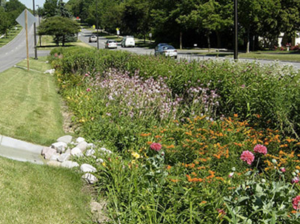
MS4 LID must be maintained.
MS4 inspection & authority.
MS4 dedicated resources.
Falls under OKR04’s 5th MCM (Post-Construction) and 6th MCM (Good Housekeeping).
Types of MS4-Owned LID include:
WQ detention basins, rain gardens, wetlands.
Green roofs, bioswales.
Permeable pavement types.
Municipal LID Structures
Notes:
The 2021 OKR04 permit has new requirements for Low Impact Development (LID) under the 5th MCM for “Post-Construction” in new development and re-development.
Inevitably, the MS4 can expect to have new structural LID facilities such as rain gardens implemented within the MS4 area, including both private and municipally owned systems.
The range in size of LID systems and structures can be as small as a simple house rain garden to a subdivision LID network of bioswales, water quality basins and constructed wetlands.
Ownership as private or public will dictate how the MS4 approaches pollution control from LID systems and performs inspections and exercises authority over LID system maintenance.
Municipally owned LID systems will fall under both OKR04’s MCM-5 and MCM-6 requirements, but private LID will fall under just OKR04’s MCM-5 requirements.

Slide 13
This ends the GCSA Training Series on OKR04 MCM-6
For more information, contact:
Vernon Seaman
Manager, Envir. And Energy Planning
INCOG
Two West 2nd Street, Ste 800
Tulsa, OK 74103
(918) 579-9451
vseaman@incog.org
Notes:
This concludes the last of 6 annotated PowerPoint (aPPT) Modules for local MCM-6 training.
Training Presentations 2 through 5 covered the training subjects listed in the OKR04 permit.
The final Presentation 6 has covered additional facilities that may be owned by GCSA Members.
INCOG expects to be able to return to physical half-day GCSA Employee Training Workshops in the second half of 2021.
In this interim period, INCOG will continue to prepare annotated PowerPoints (aPPTs) for local staff training use.

